Slide 1
Recognizing Reader’s Affect Using EEG Data
Kristine Ma. Dominique Kalaw
Researcher
Prof. Ethel Chua Joy Ong
Adviser

Slide 2
Outline of the Presentation
Introduction
Objectives
Significance
Methodology
Results & Analysis
Conclusions & Recommendations

Slide 3
Introduction

Slide 4
INTRO | Emotions
Kleinginna Jr. and Kleinginna (1981) compiled a categorized list of emotion definitions from various emotion theorists and sources of emotion literature.
Emotions play vital roles in rational and intelligent behavior (Bechara et al., 2000; Schwarz, 2000).
There are two general kinds of emotion models:
Categorical models are those that define a number of discrete basic emotions such as Ekman’s 6 basic emotions (happiness, sadness, fear, anger, disgust, surprise) (1972).
Dimensional models describe the components of emotions and are often represented as a two- or three-dimensional space such as Russell’s valence-arousal scale (1980).
Notes:
90+definitions. There is no clear definition to what emotions are.

Slide 5
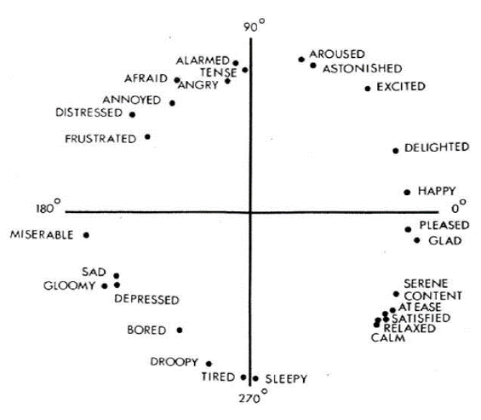
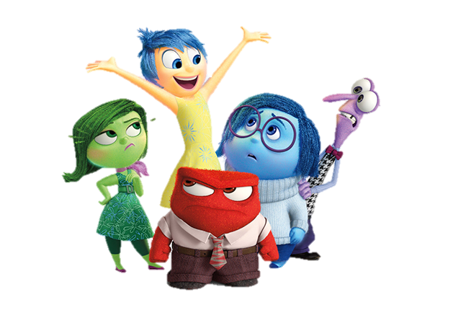
INTRO | Emotions
Categorical Model
Dimensional Model
Source: Walt Disney Pictures / Pixar Animation Studios / Inside Out (2015); Russell (1980)
Notes:
Fun fact: the Inside out director Pete Docter consulted Ekman while they were planning the film. Docter found fear and surprise to be somewhat similar so he merged them.

Slide 6
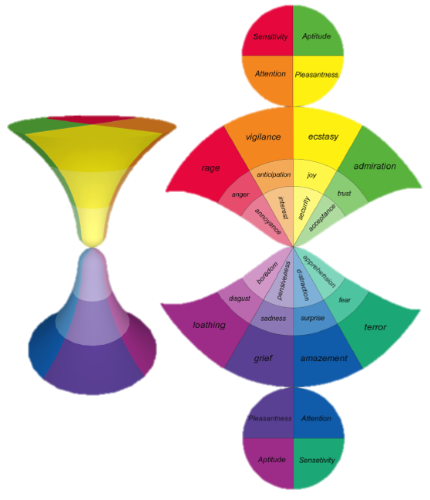
INTRO | Emotions
Pleasantness
how much the user is amused by interaction modalities
Attention
how much the user is interested in interaction contents
Sensitivity
how much the user is comfortable with interaction dynamics
Aptitude
how much the user is condent in interaction benets
Source: Cambria et al. (2012)
Notes:
Refer to p23/24. Because of the difference of the two types of models, Cambria et al proposed a novel biologically-inspired and psychologically-motivated emotion model that combines the two. In this way, they state that their model can potentially describe a full range of emotional experiences. Example: joy+trust+anger = jealousy

Slide 7
INTRO | Emotion Recognition
Affective Computing
COMP | Cannot Express Affect | Can Express Affect
Cannot Perceive Affect | [1] Most computers | [2] Synthesis
Can Perceive Affect | [3] Analysis | [4] A true “personal” and “user-friendly” computer
Relates to, arises from, or influences emotions (Picard, 1997).
Imbue the computer with emotional intelligence*
subset of social intelligence that involves the ability to monitor one's own and others' feelings and emotions, to discriminate among them and to use this information to guide one's thinking and actions (Salovey & Mayer, 1990)
Source: Picard (1997)

Slide 8
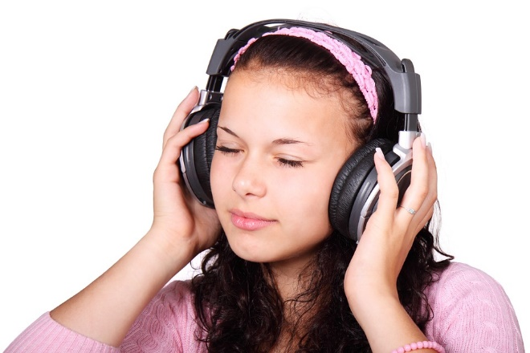
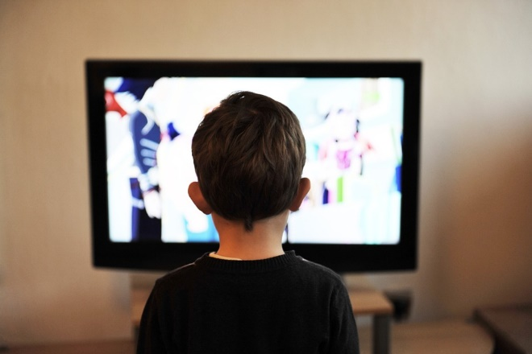
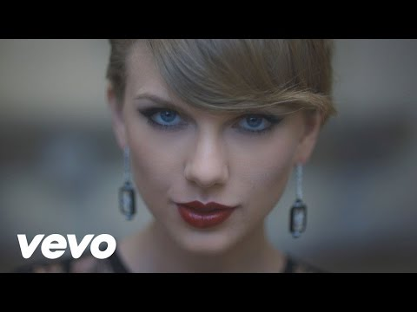

INTRO | Emotion Recognition
Apart from facial and vocal expressions, humans naturally read many physiological signals of emotions (Picard, 2000).
Emotion recognition involves pattern recognition of physiological data, one of which is brainwaves or EEG.
Listening to Music
Lin et al. (2010)
Watching Movies
Nie et al. (2011)
Watching Music Videos
Yazdani et al. (2012)
Answering Math Problems
Azcarraga & Suarez (2012)
Source: Pixabay; TaylorSwiftVEVO (Blank Space)
Notes:
Clammy hands (skin conductance) and fast heart rate can mean that a person is nervous. Please refer to p18 for the summary. All of these studies have employed MLP and SVM

Slide 9
INTRO | Emotion Recognition
Challenges
Factors to consider on gathering good affect data
Emotion model
Accuracy of the data obtained from the sensors due to technical factors
Obtaining the ground truth
Ethical and privacy issues
Subject-elicited vs. event-elicited | Does subject purposefully elicit emotion or is it elicited by a stimulus or situation outside the subject's efforts?
Lab setting vs. real-world | Is subject in a lab or in a special room that is not their usual environment?
Expression vs. feeling | Is the emphasis on external expression or on internal feeling?
Open-recording vs. hidden-recording | Does subject know that anything is being recorded?
Emotion-purpose vs. other-purpose | Does subject know that the experiment is about emotion?
Source: Picard (2000)
Notes:
Refer p11/12. The experimental set-up is event-elicited, conducted in a lab setting, concerned with feeling, is open-recorded, and is emotion-purpose.

Slide 10
INTRO | EEG
Electroencephalography (EEG) is the recorded electrical activity generated by the brain (Rossetti & Laureys, 2015).
EEG is an effective means of neuro-imaging because it is a noninvasive and safe procedure which can record in milliseconds.
Event-related potentials (ERP) are the EEG signals time-locked to a stimulus which the participant reacts to. The baseline is the time period before the stimulus is presented.

Slide 11
INTRO | EEG
Brainwave Type | Frequency Range | Mental States and Conditions
Delta δ | 0.1Hz to 3Hz | Deep, dreamless sleep, non-REM sleep, unconscious
Theta θ | 4Hz to 7Hz | Intuitive, creative, recall, fantasy, imaginary, dream
Alpha α | 8Hz to 12Hz | Relaxed, but not drowsy, tranquil, conscious
Low Beta β₁ | 12Hz to 15Hz | Formerly SMR (sensorimotor rhythm), relaxed yet focused, integrated
Mid Beta β₂ | 16Hz to 20Hz | Thinking, aware of self & surroundings
High Beta β₃ | 21Hz to 30Hz | Alertness, agitation
Gamma γ | 30Hz to 100Hz | Motor functions, higher mental activity
Source: Brain Wave Signal (EEG) of NeuroSky, Inc. (2009)
Notes:
Refer to p25. EEG is generally described in terms of its frequency bands. Each band has a certain frequency range and relates to various brain states. SMR (sensorimotor rhythm) is an EEG frequency band from 12-15 Hz that is associated with an alert, attentive state coupled with calm or silent motor activities.

Slide 12
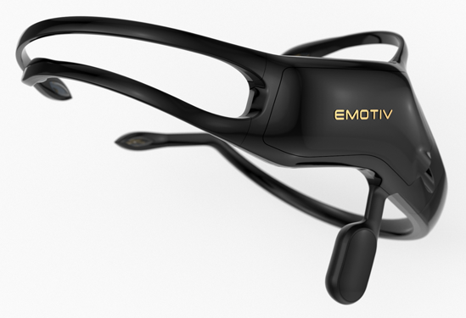
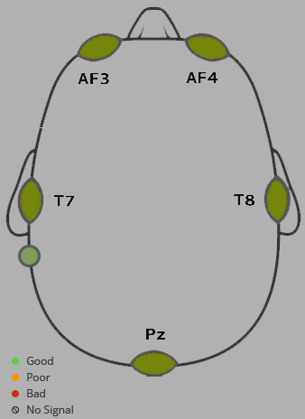
INTRO | EEG
The Emotiv Insight is a 5-channel, wireless EEG headset that records brainwaves.
It is a commercial product marketed worldwide and is designed for everyday use.
It uses a polymer sensor that is safe to use and offers great electrical conductivity with the convenience of a dry sensor.
Source: EMOTIV Inc
Notes:
The EMOTIV Insight was made available for general release in 2015. It is a 5-channel wireless EEG device covering frontal, temporal and parieto-occipital locations around the brain. This device has global recognition for its personal usage such as assessing athletic performance, cognitive training, or health and well-being. It is also backed by man independent researches

Slide 13
INTRO | Reading Fiction
Reading literary texts or fiction is not simply an activity but rather an experience that is never the same from one reading to the next (Tompkins, 1980).
Usually, when one reads non-fiction such as academic texts or news articles, the goal is to be informed. Whereas when one reads fiction such as novels, short stories, or poems, the goal is to be entertained and moved (experience a variety of emotions) (Mar et al., 2011).
Reader-response criticism is a school of literary theory that focuses on the reader, the reading process, and response, rather than the literary text itself. It is said to have started with I.A. Richard's discussion of emotional response (Tompkins, 1980).

Slide 14
INTRO | Reading Fiction
Emotions of Literary Response
Narrative Emotions
Sympathy
Identification
Aesthetic Emotions
Relived Emotions
Empathy*
Remembered Emotions*
Source: Oatley (1995); Mar et al. (2011)
Notes:
Original: Sympathy, Identification, Emotion memories

Slide 15
INTRO | Reading Fiction
Emotions of Literary Response
Evaluative Feelings
Narrative Feelings
Aesthetic Feelings
concerned with the overall enjoyment, pleasure, or satisfaction of reading the text
evoked by events or characters in the fictional world of the text
prompted by the formal (generic, narrative, or stylistic) components of a text
Self-modifying Feelings
restructure the reader's understanding of the textual narrative and, simultaneously, the readers sense of self
Source: Miall & Kuiken (2002)
Notes:
In relation to this research, it is only concerned with the first three. You will notice later on that this classification coincides with the *3rd specific objective

Slide 16
INTRO | Reading Fiction
Miall and Kuiken (1994) observes how foregrounding, or stylistic variation in the text, influences the response of the reader in terms of reading time, strikingness, and affect.
Cupchik et al. (1998) conducted a similar experiment but instead of focusing on what aspects of the texts elicited the emotional response, it is concerned with what type of emotional response the reader evoked.
Notes:
Segment stories, read, annotate

Slide 17
INTRO | Research Statement
There is no current work that has studied brainwave patterns and their association to affect while a person is reading literary fiction.
EEG
Affect
Fiction
Notes:
There have been studies establishing the association of brainwave patterns and emotions while being engaged in an activity. There have also been empirical works that have established the relation between reading and emotions or emotional response in areas of culture, media, and arts.

Slide 18
Objectives

Slide 19
General Objective
To build an affect model that maps the EEG signals collected from readers (while they are reading stories) to specific emotions.

Slide 20
Specific Objective #1
Objective
Scope and Limitation
To review the approaches, methodologies, and experiments of existing affect detection or recognition studies that uses EEG data;
A review of existing affect detection or recognition studies that uses EEG data.

Slide 21
Specific Objective #2
Objective
Scope and Limitation
To identify the different emotions that can be elicited from the readers as they read the stories;
A review of different emotion models and determine which of them is appropriate for reader affect.

Slide 22
Specific Objective #3
Objective
Scope and Limitation
To determine which elements of a story affect the reader's emotional state;
The study will attempt to determine which element of the story triggered the reader to evoke that emotion.
character traits and behavior
reader's empathy to the character
the story plot or casual chain of story events
lexical choices and sentence structure.

Slide 23
Specific Objective #4
Objective
Scope and Limitation
To build a corpus of EEG signals;
The participants will be people aged 18 and above
They will read pre-selected short stories while an EEG sensor is attached to them
Notes:
Refer to Sec4.2 on p30 for short stories

Slide 24
Specific Objective #5
Objective
Scope and Limitation
To implement machine learning algorithms for classifying the emotion based on the EEG signals;
Weka
RapidMiner

Slide 25
Specific Objective #6
Objective
Scope and Limitation
To define evaluation metrics for assessing the performance of the model;
Supervised ML
Precision
Recall
Accuracy
F-measure
Unsupervised ML
To be determined

Slide 26
Significance

Slide 27
SGFNT | Affective Computing
Explore the feasibility and application of these existing areas on an unexplored domain.
Affective Computing
Wearable computing
Computer Vision
Pattern Recognition
Machine Learning
Digital Signal Processing
Human-Computer Interaction

Slide 28
SGFNT | Methodology & Experiments
Serve as basis and reference for related future studies.
Data Collection
Data Preparation
Preprocessing
Classification
Notes:
Ex. Miall and Kuiken experiment

Slide 29
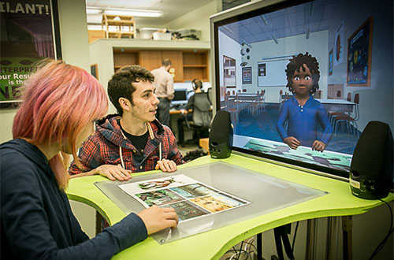
SGFNT | Affect-Related Systems
Results of this study can be further utilized in intelligent tutoring systems (ITS) or embodied conversational agents (ECA).
Source: ArticuLab / Carnegie Mellon University / Project Alex
Notes:
These kinds of systems replicate face-to-face human interactions with, for example, a digital avatar. Since these systems serves as stand-ins for humans, it should at least, on a certain level, feel like having a natural interaction with a human. This is the 4th category in Affective Computing

Slide 30

SGFNT | Beyond Computer Science
The findings of this work may be informative to affective science, psychology, and other related fields.
Source: Open University
Notes:
Emotion detection can also be an indicator for behavior prediction, most especially when monitoring certain emotional states that could lead to potentially harmful or dangerous behaviors.

Slide 31


SGFNT | Beyond Computer Science
Business perspective
By knowing their target audience's likes or dislikes, companies can efficiently create more effective products or services
Consumer perspective
Revamping the rating, reviewing, and recommendation system
Source: Lazada; Amazon
Notes:
So if there is some way to refine the rating and reviewing system to be automatic or semi-automatic and to present the detected emotions in an intuitive and objective manner, then the
consumers could make informed decisions and know that the product or service is truly worth their money. Another example can be considering emotions as tags for content media retrieval such as looking for book recommendations that makes you feel happy.

Slide 32
Methodology

Slide 33
MTHD | Calendar of Activities
 | JAN ’16 | FEB | MAR | APR | MAY | JUN | JUL | AUG | SEP | OCT | NOV | DEC | JAN ‘17 | FEB | MAR | APR
(1) | **** | **** | **** | **--
(2) |  |  | --** | **-- | **--
(3) |  |  |  |  | --** | **** | **-- |  |  |  | --** | *--- | **** | ****
(4) |  |  |  |  |  |  | **** | ***- | -*** | **** |  |  | **** | **** | **--
(5) | --** | **** | **** | **-- | **** | **** | **** | ***- | -*** | **** | **** | *--- | **** | **** | **** | *---
Concept Formulation and Review of Related Literature
Development of Data Collector Tool
Data Collection and Corpus Building
Training and Evaluation
Documentation
Notes:
Refer to page 9

Slide 34
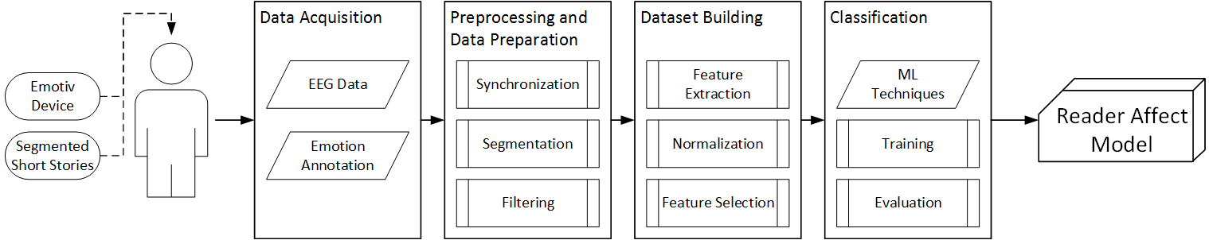
MTHD | Research Framework
Notes:
Refer to p33. Refer to p34 These short stories were recommended by the director of the creative writing department of DLSU. The segments were also approved by her (Refer Appendix C).

Slide 35
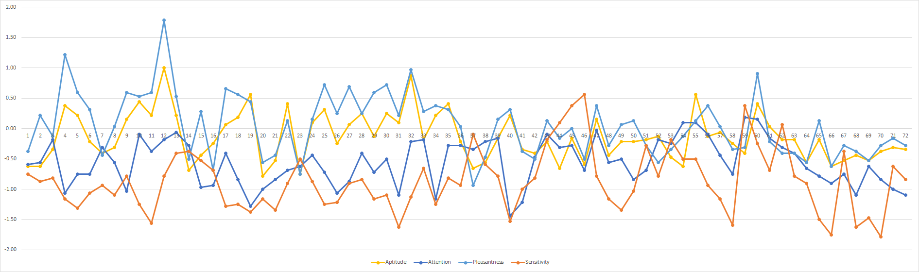
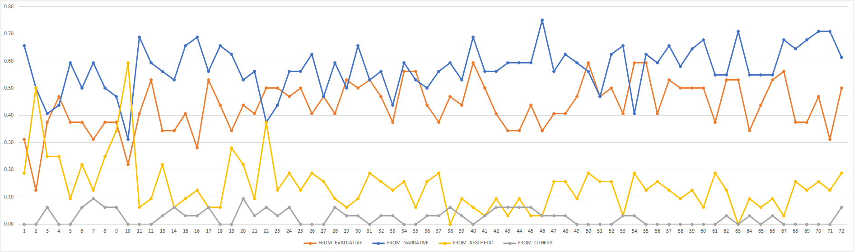
Notes:
Refer to p56. The Veldt by Ray Bradbury is a story of a family who lives in an automated house with machines and gadgets that do all the work for them. This house has a nursery room that is able to create virtual realities in response to the telepathic wishes of the children.
the exposition consists of segments 1 to 17, the rising action consists of segments 18 to 46, the climax consists of segments 47 to 58, the falling action consists of segments 59 to 70, and the resolution consists of segments 71 to 72.
These are the emotions of the participants towards the story
Hourglass of Emotions
AP: hate/love
AT: not expecting/expecting
PL: sad/happy
SE: fear/rage
Emotions of Literary Response
AE: forgrounding
EV: overall enjoyment
NA: character/plot

Slide 36
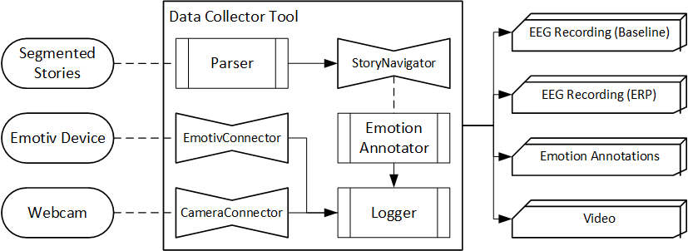
MTHD | Data Collector Tool
Notes:
Refer to p36. Developed in C#. 3 main module: connector, parser, logger.

Slide 37
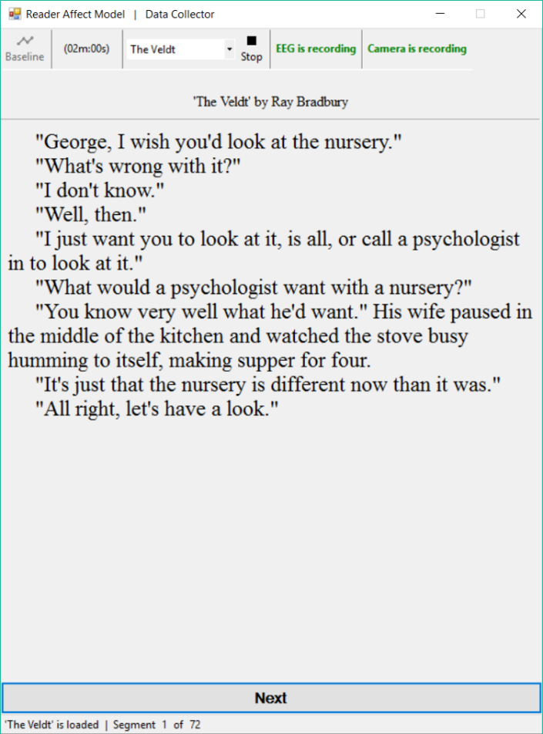
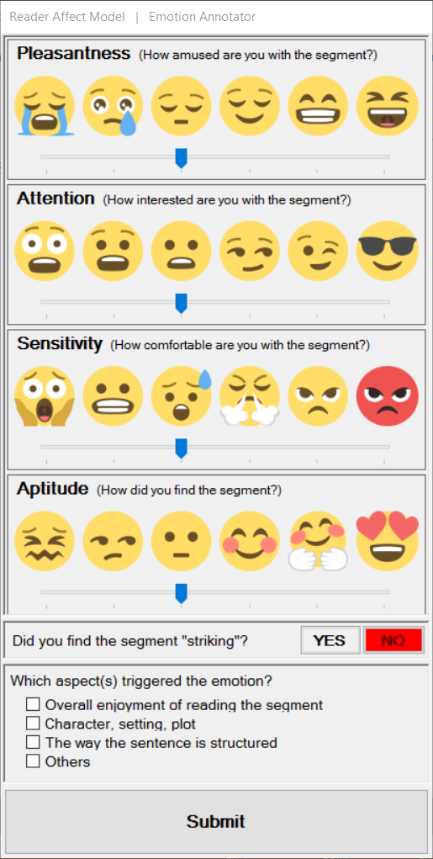
MTHD | Data Collector Tool
Notes:
Refer to p37. Upper is hourglass of emotions, lower is emotions of literary response
Hourglass of Emotions
AP: hate/love
AT: not expecting/expecting
PL: sad/happy
SE: fear/rage
Emotions of Literary Response
AE: forgrounding
EV: overall enjoyment
NA: character/plot

Slide 38
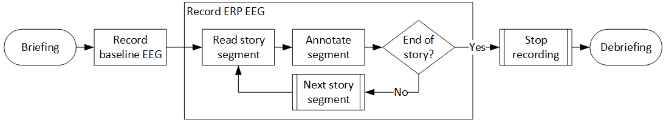
MTHD | Data Acquisition
Notes:
Refer to P44/45. Apart from the four EEG studies, the experiment is also patterned after Miall and Kuiken (1994).
Collected data from DLSU students. First impressions to the story. Experienced technical factors that might skew the accuracy of the data.

Slide 39
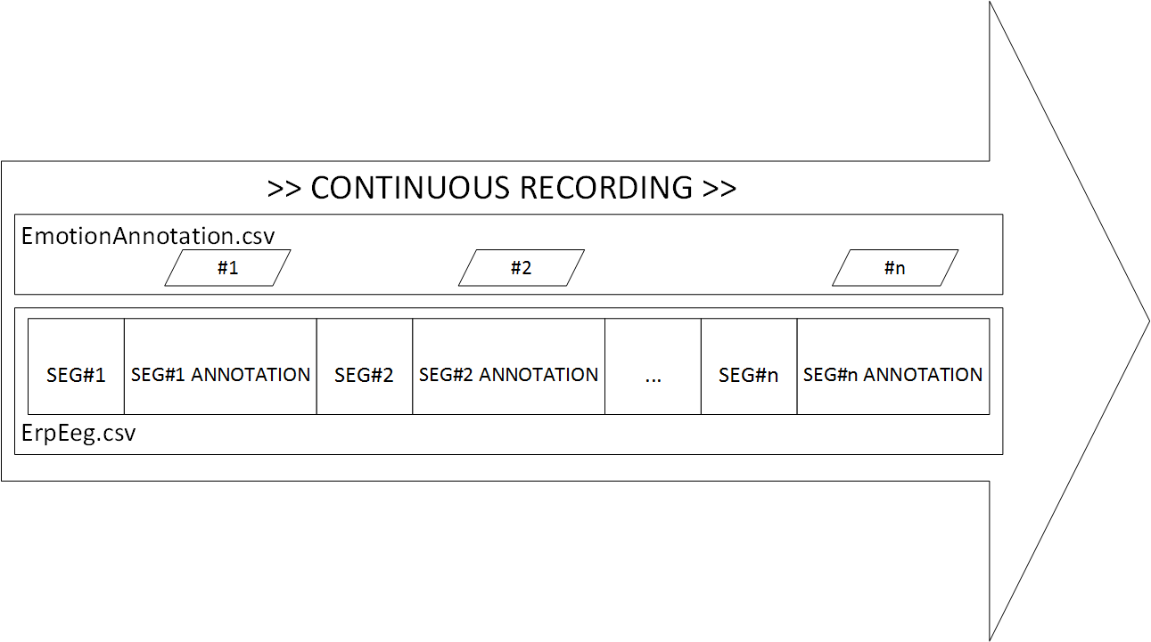
MTHD | EEG Processing
Notes:
Refer to p46. This is what it looks like before processing.

Slide 40
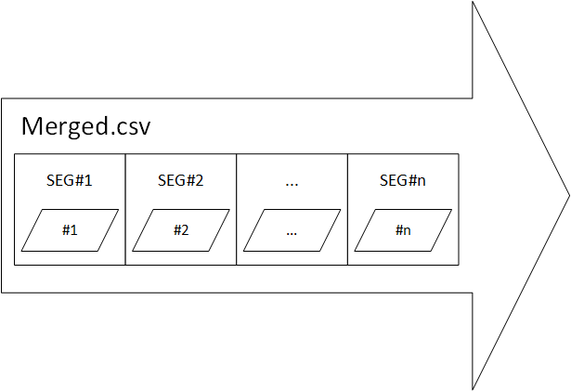
MTHD | EEG Processing
Notes:
Refer to p47. Remove the chunk where the participants were annotating the segment

Slide 41
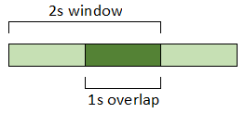
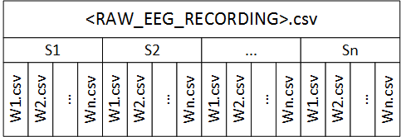
MTHD | EEG Processing
Notes:
Refer to p48. Windowing, resulting files after applying windowing. One window is one instance.

Slide 42
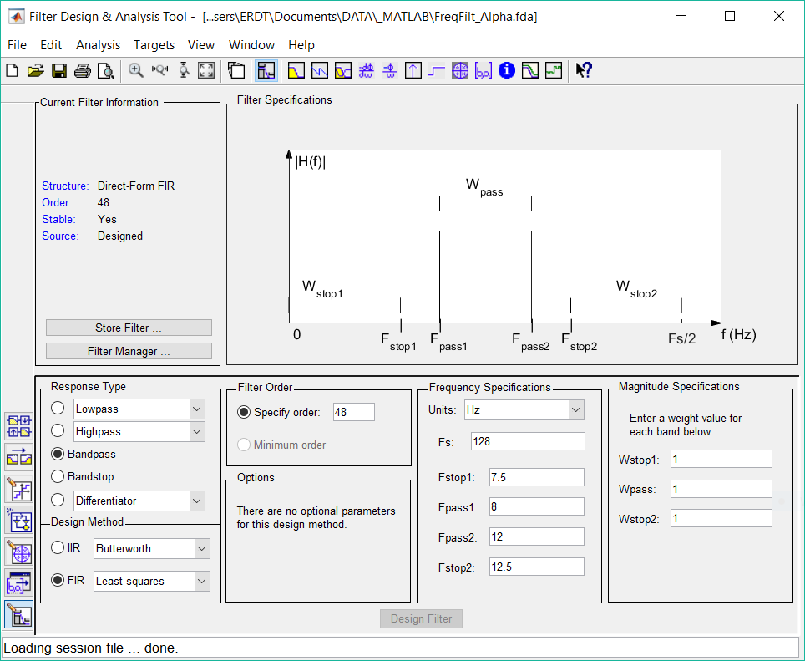
MTHD | Feature Extraction
Notes:
Refer to p49 for the screenshot. Using the definition of eegfilt() as shown in p48, we recreate it in MATLAB’s fdatool by replacing the parameters.

Slide 43
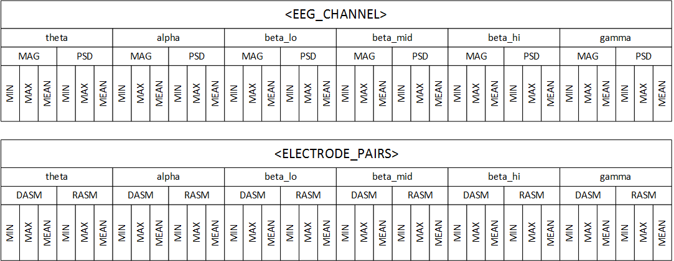
MTHD | Feature Extraction
Notes:
Refer to p50. Using a different filters, we extract the frequency bands, transform the signal using FFT and then compute for the following feature types (refer to p29): magnitude, power spectral density, spectral power of the asymmetric electrode pairs (RASM, DASM). From these feature types we get their min, max, mean value. This makes a total of 252 extracted EEG features.

Slide 44
MTHD | Class Labels
Hourglass of Emotions (HoE)
Emotions of Literary Response (ELR)
Aptitude (AP)
Attention (AT)
Pleasantness (PL)
Sensitivity (SE)
high/low
Aesthetic feelings (AE)
Evaluative feelings (EV)
Narrative feelings (NA)
Others (OT)
true/false
Notes:
AP: hate/love
AT: not expecting/expecting
PL: sad/happy
SE: fear/rage
AE: forgrounding
EV: overall enjoyment
NA: character/plot

Slide 45
MTHD | Dataset Building
Profile | Dataset | # of Participants
P1: Sex | Female | 27
 | Male | 9
P2: Reading Preference (Traditional books vs. eBooks) | RP1: Prefers reading traditional books only | 8
 | RP2: Prefers traditional books over eBooks | 12
 | RP3: Fine with both traditional books and eBooks | 10
 | RP4: Prefers eBooks over traditional books | 3
 | RP5: Prefers reading eBooks only | 0
P3: Reading Frequency (How often do you read for fun?) | RF1: Almost all the time (approx. 1-2 books a week) | 2
 | RF2: Now and then (approx. 1-2 books a month) | 14
 | RF3: Not very often (approx. 1-2 books in 6 months) | 14
 | RF4: Never | 2
Notes:
Refer to p52. Use z-scores for normalization. Refer to p54/55 for distribution of the instances per class label per dataset.

Slide 46
Results & Analysis

Slide 47
R&A | Experiments
Dataset: Female, Male, RP1, RP2, RP3, RP4, RF1, RF2, RF3, RF4, Sex-merged, RP-merged, RF-merged
Classification Method: DT, SVM, MLP
HoE class labels (high/low): Aptitude AP, Attention AT, Pleasantness PL, Sensitivity SE
ELR class labels (true/false): Aesthetic feelings AE, Evaluative feelings EV, Narrative feelings NA, Others OT
Notes:
Leave-one-participant-out cross-validation

Slide 48
R&A | Evaluation Metrics
Accuracy
Precision
Recall
F-measure
Cohen’s Kappa
Notes:
Refer to p57. F-measure is the main metric used for comparison because accuracy is not reliable. More so because of the uneven distribution of instances.

Slide 49
R&A | Results
 | HoE | ELR
Baseline Classification Performance Based on DT | ☺ | ☺
Improving Classification Performance with SVM or MLP | ☺ | ☺
Feature Selection with PCA | ☺ | ☺
Notes:
the goal was set the baseline performance using Decision Trees and to see if whether there is an improvement in performance among the profile-specific datasets.
The goal of this experiment is to attempt to improve the classification performance with SVM and MLP classifiers.
In this experiment, the goal is to see whether reducing the number of features could yield that is higher than or at least at par with the base feature set.

Slide 50
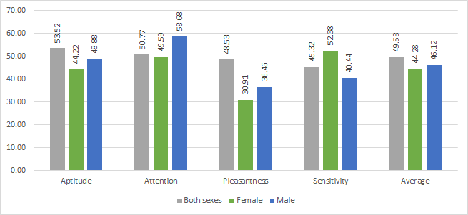
R&A | HoE: Sex Datasets
Sex | RP | RF
Notes:
Aptitude pertains to whether the reader hated (\textit{low}) or loved (\textit{high}) what happened in the segment.
males and females have no distinguishing difference in loving or hating a story
Attention pertains to the reader's level of interest to the events in segment. It means that the reader is either amazed at the event that happened (\textit{low}) or that they were already expecting it to happen (\textit{high}).
In terms of percentage, the Male dataset has more \textit{high} instances than the Female and combined sex datasets. This is consistent with what the male participants have said during the debriefing, wherein they reported that they already have an inkling on what was going to happen. This is in line with \shortciteA{kret_review_2012}, wherein they state the men respond better to threatening cues.
Pleasantness pertains to the reader's amusement towards the events in the segment, on whether they were sad (\textit{low}) or happy (\textit{high}) about it.
Sensitivity pertains to whether the reader feared (\textit{low}) or was angered (\textit{high}) with the events in the segment.
With regard to the females, it is consistent with their debriefing reports wherein they expressed more anger or fear on certain elements of the story, such as the characters or the plot events, than the males.

Slide 51
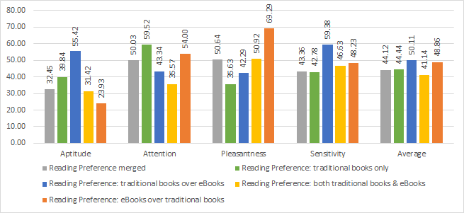
R&A | HoE: RP Datasets
Sex | RP | RF
Notes:
Aptitude pertains to whether the reader hated (\textit{low}) or loved (\textit{high}) what happened in the segment.
people who prefer reading traditional books (RP1, RP2)
Attention pertains to the reader's level of interest to the events in segment. It means that the reader is either amazed at the event that happened (\textit{low}) or that they were already expecting it to happen (\textit{high}).
RP4 predicted most of its instances as \textit{high}, that is, only 6 instances as \textit{low}.
Pleasantness pertains to the reader's amusement towards the events in the segment, on whether they were sad (\textit{low}) or happy (\textit{high}) about it.
The results show that the classifier for people who prefer reading eBooks over traditional books (RP4) yielded the best performance among all the PL DT classifications. Since the story segments were presented via a software program on a laptop (i.e. not a traditional book), it can be presumed that those who prefer reading traditional books have a certain bias clouding their enjoyment of the story. The said presumption is consistent because of the increase in performance of the f-measure values (35.63 for RP1, 42.29 for RP2, 50.92 for RP3, and 69.29 for RP4).
Sensitivity pertains to whether the reader feared (\textit{low}) or was angered (\textit{high}) with the events in the segment.
The RP2 dataset classifier may have yielded the best performance but it may be because it was the only relatively balanced dataset among the RP profiles.

Slide 52
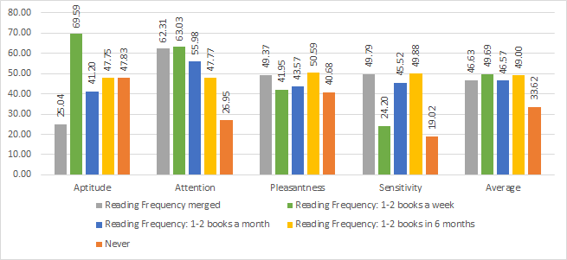
R&A | HoE: RF Datasets
Sex | RP | RF
Notes:
Aptitude pertains to whether the reader hated (\textit{low}) or loved (\textit{high}) what happened in the segment.
The RF2 and RF3 datasets are cases of the accuracy paradox, wherein RF2 predicted all instances as \textit{high} and RF3 predicted all instances as \textit{low}. This may be due to RF2 having more \textit{high} instances than \textit{low} and the inverse for RF3.
people who always reads for fun (RF1), and rarely reads for fun (RF4)
Attention pertains to the reader's level of interest to the events in segment. It means that the reader is either amazed at the event that happened (\textit{low}) or that they were already expecting it to happen (\textit{high}).
Another observation worth noting is in the RF profiles. The scenario is that the RF1 and RF2 datasets in this class label are relatively balanced, while the RF3 predicted all instances as \textit{high} and the RF4 predicted all instances as \textit{low}. However, it is intriguing to see the decline in the classification performances (63.03 for RF1, 55.98 for RF2, 47.77 for RF3, and 26.95 for RF4). People who always or frequently reads for fun are accustomed on keeping track of the events in the story, and this accustomedness reflected in their brainwaves.
Pleasantness pertains to the reader's amusement towards the events in the segment, on whether they were sad (\textit{low}) or happy (\textit{high}) about it.
Sensitivity pertains to whether the reader feared (\textit{low}) or was angered (\textit{high}) with the events in the segment.

Slide 53
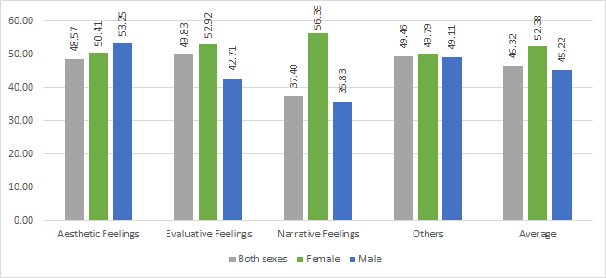
R&A | ELR: Sex Datasets
Sex | RP | RF
Notes:
Aesthetic feelings are caused by the formal (generic, narrative, or stylistic) components of the text in the segment. This is where the foregrounding that \shortciteA{miall_foregrounding_1994} was talking about. It should be noted that in all cases of the datasets, there is a significant percentage that marks the \textit{false} presence of this class label. Only an average of 15\% of the instances are marked as \textit{true}.
It is observed that there is a gradual increase in the Sex datasets (50.41 for Female and 53.25 for Male)
Evaluative feelings are concerned with the overall enjoyment, pleasure, or satisfaction in reading the segment.
The Female dataset yielded the best performance in predicting this class label than the Male and combined sex datasets. This is consistent with the notion that women are more expressive than men \cite{kret_review_2012}.
Narrative feelings are evoked by the events or characters in the segment.
- On the other hand, the Female dataset gave the best performance than the Male and combined sex dataset. In the debriefing reports, both sexes have expressed that the plot or the characters are the main causes of their emotions. However, it is worth noting that females expounded more on why the plot or characters evoked such emotions. Hence, it is inferred that women's sympathy, empathy, or identification with the character and responses towards the plot events are registered more on their brainwaves rather than men's, a notion consistent with the study of \shortciteA{kret_review_2012}

Slide 54
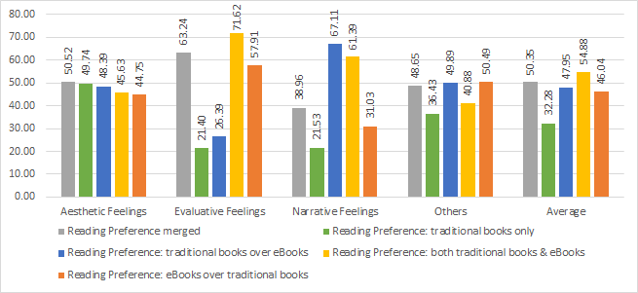
R&A | ELR: RP Datasets
Sex | RP | RF
Notes:
Aesthetic feelings are caused by the formal (generic, narrative, or stylistic) components of the text in the segment. This is where the foregrounding that \shortciteA{miall_foregrounding_1994} was talking about. It should be noted that in all cases of the datasets, there is a significant percentage that marks the \textit{false} presence of this class label. Only an average of 15\% of the instances are marked as \textit{true}.
a gradual decrease in RP datasets (49.74 for RP1, 48.39 for RP2, 45.63 for RP3, and 44.75 for RP4).
Evaluative feelings are concerned with the overall enjoyment, pleasure, or satisfaction in reading the segment.
With regard to the RP datasets, it is interesting to note that those who prefer traditional books (RP1, RP2) have classifiers with a lower performance as opposed to those who prefer eBooks (RP3, RP4). It can be surmised that this is somewhat similar to the case of the RP datasets in predicting Pleasantness, wherein the displaying the story segments via a laptop screen presents an unconscious bias in the reader.
Narrative feelings are evoked by the events or characters in the segment.
- It is observed that the classifiers for the RP3, RP4, RF2, and RF4 datasets yielded significantly better performances than their respective general datasets. Further analysis and research into this case is needed as no inference or assumption comes to mind.

Slide 55
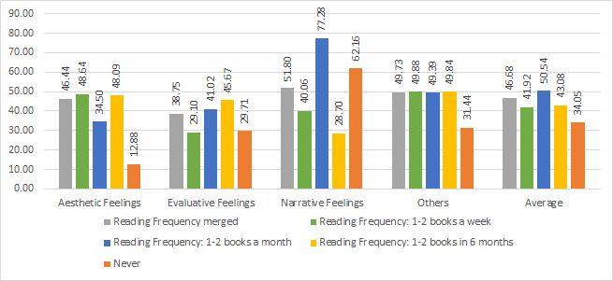
R&A | ELR: RF Datasets
Sex | RP | RF
Notes:
Aesthetic feelings are caused by the formal (generic, narrative, or stylistic) components of the text in the segment. This is where the foregrounding that \shortciteA{miall_foregrounding_1994} was talking about. It should be noted that in all cases of the datasets, there is a significant percentage that marks the \textit{false} presence of this class label. Only an average of 15\% of the instances are marked as \textit{true}.
With regard to the RF datasets, RF4 yielded the worst performance because its classifier predicted all of its instances as \textit{true} (which is approximately 15\% of the total instances).
Following what \shortciteA{miall_foregrounding_1994} has presented, wherein it can be considered that their reading profiles are having a high level of literary competence or not, it can be assumed that the response or emotions evoked towards formal components of the text is the same on other reading profiles (i.e. sex, reading preference, reading frequency). Note that further testing could be done to prove or disprove assumption due to the imbalanced datasets and that these are the first impressions of the participants towards the story. Most of them reported the other two class ELR class labels as the cause of their emotions during their debriefings.
Evaluative feelings are concerned with the overall enjoyment, pleasure, or satisfaction in reading the segment.
Narrative feelings are evoked by the events or characters in the segment.
- It is observed that the classifiers for the RP3, RP4, RF2, and RF4 datasets yielded significantly better performances than their respective general datasets. Further analysis and research into this case is needed as no inference or assumption comes to mind.

Slide 56
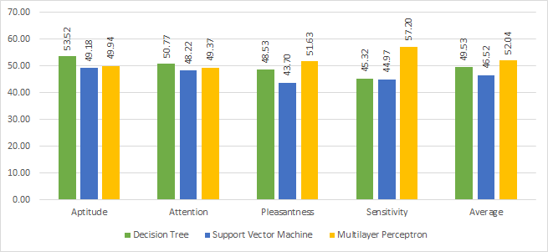
R&A | HoE: Sex Dataset
Sex | RP | RF

Slide 57
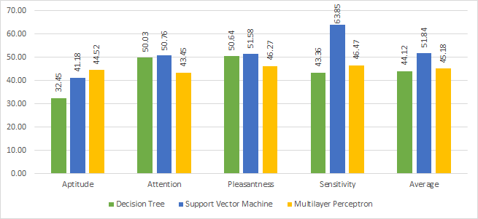
R&A | HoE: RP Dataset
Sex | RP | RF

Slide 58
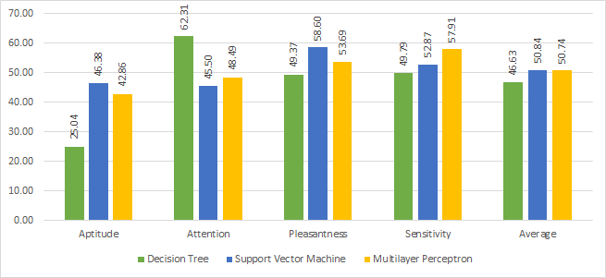
R&A | HoE: RF Dataset
Sex | RP | RF

Slide 59
R&A | HoE: Synthesis
 |  | DT | SVM | MLP
SEX | AP | ☺
 | AT | ☺
 | PL |  |  | ☺
 | SE |  |  | ☺
RP | AP |  |  | ☺
 | AT |  | ☺
 | PL |  | ☺
 | SE |  |  | ☺
RF | AP |  | ☺
 | AT | ☺
 | PL |  | ☺
 | SE |  |  | ☺
 |  | 3 | 4 | 5
Notes:
It is observed that on average, SVM or MLP yield a slightly better performance in predicting class labels than DT, or at least on par with DT. Not considering the performance of the classifiers with accuracy paradoxes (distinguished by having a recall of 50\% and kappa of 0), DT outperformed the other two 3 times, SVM outperformed the other two 4 times, and MLP outperformed the other two 5 times for HoE; whereas DT outperformed the other two 1 time, SVM outperformed the other two 2 times, and MLP outperformed the other two 9 times for ELR.

Slide 60
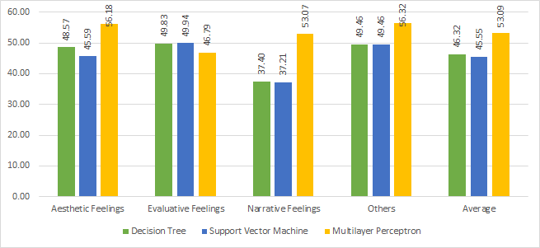
R&A | ELR: Sex Dataset
Sex | RP | RF

Slide 61
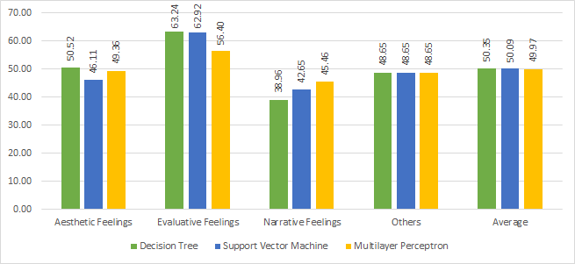
R&A | ELR: RP Dataset
Sex | RP | RF

Slide 62
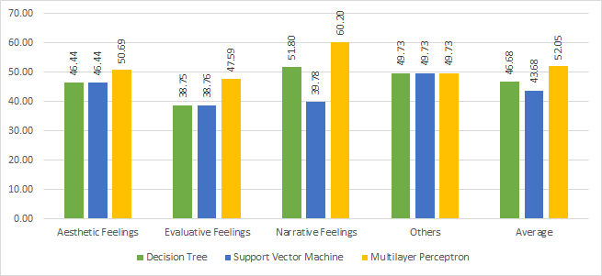
R&A | ELR: RF Dataset
Sex | RP | RF

Slide 63
R&A | ELR: Synthesis
 |  | DT | SVM | MLP
SEX | AE |  |  | ☺
 | EV |  | ☺
 | NA |  |  | ☺
 | OT |  |  | ☺
RP | AE | ☺
 | EV |  | ☺
 | NA |  |  | ☺
 | OT |  |  | ☺
RF | AE |  |  | ☺
 | EV |  |  | ☺
 | NA |  |  | ☺
 | OT |  |  | ☺
 |  | 1 | 2 | 9
Notes:
It is observed that on average, SVM or MLP yield a slightly better performance in predicting class labels than DT, or at least on par with DT. Not considering the performance of the classifiers with accuracy paradoxes (distinguished by having a recall of 50\% and kappa of 0), DT outperformed the other two 3 times, SVM outperformed the other two 4 times, and MLP outperformed the other two 5 times for HoE; whereas DT outperformed the other two 1 time, SVM outperformed the other two 2 times, and MLP outperformed the other two 9 times for ELR.

Slide 64
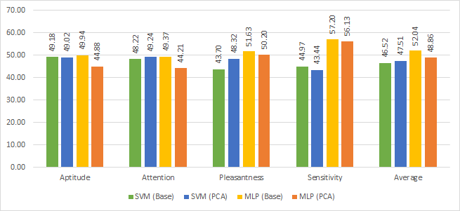
R&A | HoE: Sex Dataset
Sex | RP | RF

Slide 65
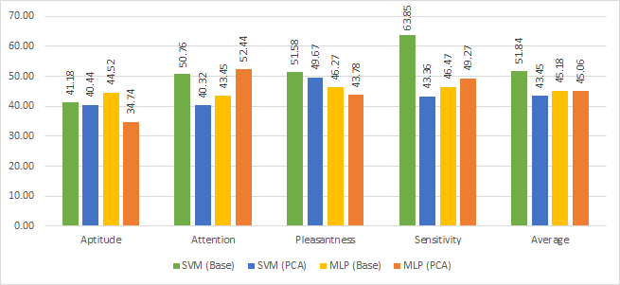
R&A | HoE: RP Dataset
Sex | RP | RF

Slide 66
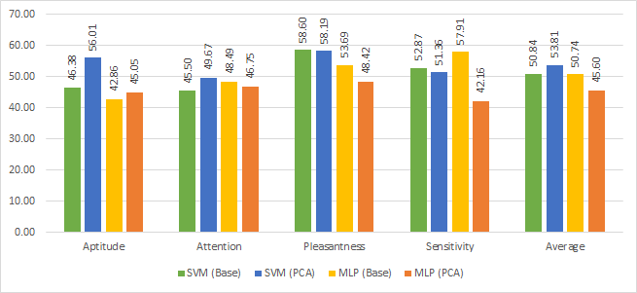
R&A | HoE: RF Dataset
Sex | RP | RF

Slide 67
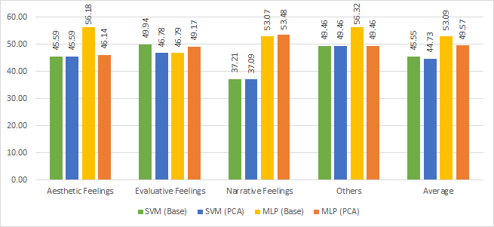
R&A | ELR: Sex Dataset
Sex | RP | RF

Slide 68
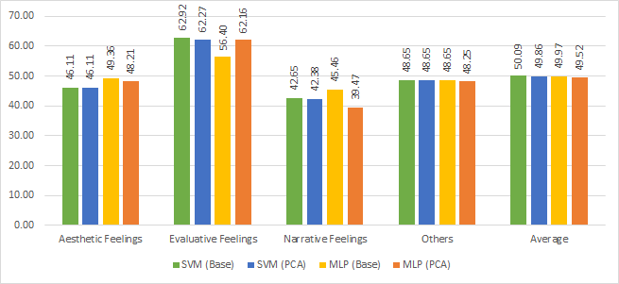
R&A | ELR: RP Dataset
Sex | RP | RF

Slide 69
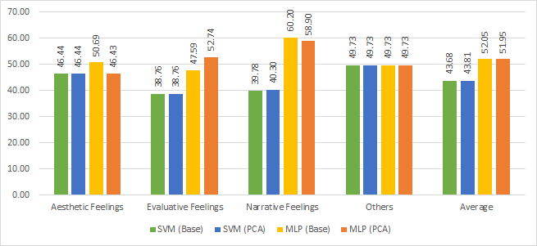
R&A | ELR: RF Dataset
Sex | RP | RF
Notes:
On an average basis, it is observed that the the performance of the classifiers with PCA feature sets yield subpar results to that of its counterpart with the base feature set of 252 EEG features.
The average difference in f-measure value of the Base classifiers and PCA classifiers for both SVM and MLP is $\rpm$5. Note that the processing of the base feature set on either MLP or SVM takes a lot of computer resources and processing time.
The Sex-merged dataset, having approximately 45,000 instances, took a little more than 3 days to finish processing the MLP (Base) classifiers. Meanwhile, the MLP (PCA) classifier for that same dataset took approximately 10 hours to finish processing.
Hence, if it is acceptable to have a $\rpm$5 margin of error, then using the PCA feature set would suffice as compensation for faster processing time.

Slide 70
Conclusions & Recommendations

Slide 71
C&R | General Objective
To build an affect model that maps the EEG signals collected from readers (while they are reading stories) to specific emotions.
Notes:
The current work presents a study on brainwaves or EEG signals and their association to emotions while a person is reading literary fiction. This is done by building an affect model that maps the brainwaves collected from readers, while they are reading short stories, to specific emotions.

Slide 72
C&R | Specific Objective #1
Objective
To review the approaches, methodologies, and experiments of existing affect detection or recognition studies that uses EEG data;
RRL + theoretical framework
Research framework and methodology
E.g. data acquisition methodology

Slide 73
C&R | Specific Objective #2
Objective
To identify the different emotions that can be elicited from the readers as they read the stories;
Hourglass of Emotions model by Cambria et al. (2012)

Slide 74
C&R | Specific Objective #3
Objective
To determine which elements of a story affect the reader's emotional state;
Emotions of Literary Response by Miall & Kuiken (2002)

Slide 75
C&R | Specific Objective #4
Objective
To build a corpus of EEG signals;
32 participants
The Veldt by Ray Bradbury
Magnitude, PSD, DASM, RASM
Sex, reading preference, reading frequency
Notes:
Refer to Sec4.2 on p30 for short stories

Slide 76
C&R | Specific Objective #5
Objective
To implement machine learning algorithms for classifying the emotion based on the EEG signals;
RapidMiner
Decision Tree, Support Vector Machine, Multilayer Perceptron
Principal Component Analysis

Slide 77
C&R | Specific Objective #6
Objective
To define evaluation metrics for assessing the performance of the model;
Accuracy
Precision
Recall
F-measure
Cohen’s Kappa

Slide 78
C&R | Analyses, Inferences, Assumptions
According to the DT models, all the relevant features are from the alpha α and theta θ bands only. This is quite interesting to take note of because the mental activity concerned with reading is in line with the accompanying descriptions of these two frequency bands.
Generally, there is no significant improvement in the performance between the combined datasets and its corresponding profile-specific datasets. However, in reviewing the results on a case-by-case basis, it is observed that they are consistent and in line with the debriefing interviews and other reviewed studies.

Slide 79
C&R | Analyses, Inferences, Assumptions
Generally, SVM or MLP yielded better performance results than DT by a small degree. Note that these classifiers were implemented with the default parameters RapidMiner has already provided. So, there is a possibility to increase the performance results by adjusting the parameters.
Classification experiments with feature selection via PCA yielded comparable performance results with an average ±5 margin of error. If such a margin is acceptable, then using the PCA feature set would suffice as compensation for faster processing time. Like the previous item, there is a possibility to increase the performance results since only the default parameters were used.

Slide 80
C&R | Recommendations
Data
Classification
Analysis
Data collection process
Tweak the parameters
Consult with experts
More reader profiles
More feature sets
More EEG features
Visualization
Balanced datasets
More ML techniques
Different stimuli
Notes:
The collected data is one of the most relevant components in researches such as this. This is the input for the experiments and test from which results and new findings are generated. Hence, here are recommendations for further work on data collection, processing, and dataset building:
- Improvements in the data collection process is advisable because the current acquisition process introduces added distractions that may have affected the gathered EEG data. It can be something as simple as tweaking the user interface to make it be more intuitive and easier to use. Design a data acquisition process in such a way that what the participant would be doing is as near as to what is naturally possible. Also refer to the notes in participant feedback in Sec 5.4 p77
- Other types of profiles could be considered such as personality types or degrees of literary competence. In the current work, specific profiles did not outperform the general classifiers but interesting inferences could still be obtained on a case by case basis.
- The usage of more feature type and/or more EEG channels could be considered. The current work only uses AF3, AF4, T7, T8, and Pz channels. The other channels may contain relevant features in these kinds of classification tasks.
- The current classification models suffered from the accuracy paradox. It is recommended to have more participants and apply techniques to balance the datasets such as oversampling the label with the least amount of instances.
- Applying the current methodology on other stories or different stimuli may yield different and notable results. Certain stories can evoke only certain kinds of emotions. For example, a suspense or thriller story is geared towards the extreme levels of attention, whereas a horror story is geared towards low sensitivity. On the other hand, examples of different stimuli are poems or news articles. Both can be read in one sitting, and the latter could be considered as a story told in a factual narrative. These two presents different writing styles which is aligned with aesthetic feelings.
It was mentioned in the previous chapter that there are still possibilities for improving the performance of the classification. Below are future work that can be done on classification and feature selection:
- The tests for this study immediately started with setting up general profile datasets (i.e. sex, reading preference, and reading frequency). A test on running the classification experiments on all the instances of the dataset could be done and compare the results to the general profile datasets.
- Default parameters provided by RapidMiner were utilized in the classification experiments. Further testing with adjusting the parameters is recommended.
- Other feature sets that can be used are the relevant features output by the DT models. Likewise, feature selection by k-Means clustering could also be employed. The current work made use of all 252 features. These 252 is composed of MSP, PSD, RASM, and DASM. Selecting only a specific feature type or a combination of these can be done.
- Only DT, SVM, and MLP were the machine learning algorithms used in the experiments. Tests exploring other supervised and unsupervised machine learning algorithms is recommended.
An last but not the least, analyzing and interpreting why the classification experiments yielded particular results is just as important too. Here are the recommendations for this area:
- Generally speaking, this is an interdisciplinary research. Despite the researcher having read various literature on the subject matter, she cannot claim expertise on certain aspects of the research. Hence, it is recommended to consult with experts on reader-response and EEG.
- Means of visualizing and showing the trajectory may lead to the discovery notable patterns that other affect-aware systems can utilize.

Slide 81
Thank you for listening!

